Slide 1

Global Technologies
XD12R
The RGB(CM) LED Current Sink Driver IC
12 Channels
General Description
The XD12R is a 12-channel constant current sink RGB(CM) LED driver for display backlight systems.
While conventional RGB backlight systems require separate three channels for red, green, and blue LED pixels, the XD12R achieves multiplexed driving for full-color RGB backlight pixels with one or two channels.
This approach allows single-layer BLU implementation, significantly reducing PCB layers.
Each channel supports up to 64mA of output current and a maximum output voltage of 40V and can time-share up to three LEDs per channel.
This device can support max 14-bit PWM dimming resolution and a 12-bit DAC global brightness resolution and max. 5-colors.
To ensure stable, flicker-free RGB time-sequential operation, the device features optimized subframe timing control and precise current regulation to effectively suppress flickering caused by rapid color transitions.
Integrated self-protection features include LED open/short detection and overheating shutdown. A feedback control function is also included to optimize the VLED voltage during LED operation, improving power efficiency.
The XD12R can be controlled with several commands through a XC24R controller or directly by a MCU. Multiple XD12R devices can be daisy-chained and controlled via a serial interface from a single XC24R, enabling scalable, high-channel-count RGB LED backlight systems for large-area displays.
Application
RGB Mini-LED Backlight for Premium TV and Monitor.
Automotive Center Information Display (CID) RGB Backlight.
RGB Backlight for Automotive Display.
(Cluster, Center Information, Entertainment)

Slide 2
XD12R
Features
Specialized to support RGB(CM) backlight dimming
Flexible for various LED pixel configuration:
Type-A(3-colors), Type-B(4-colors), Type-C (5-colors), TYPE-D (2-colors)
Bi-directional 1-wire daisy chain (31 serial) connection with configurable data rate
max. 5-colors supported ( RED, GREEN, BLUE, CYAN, MAGENTA )
Support Interface parity function
12-channel output sink drivers with programmable max. current 64mA
12-bit global brightness control
Configurable 12-bit PWM or 14-bit PWM
Support internal OSC frequency spread function for EMI rejection
Programmable output headroom voltage
Configurable dimming directions, head shift lighting and tail shift lighting
Sync controllability between daisied devices (sync-generation)
Optimal IC pin configuration allows for single layer PCB
Supply voltage 3.0 ~ 3.6V
Maximum 40V output driver working (headroom) voltage
Programmable LED SHORT detection level
Enable/disable OPEN detection
Programmable FEEDBACK detection level
Programmable Over-Temperature Shutdown (Typ. 130 ℃)
Enable/disable Over/Under-Voltage detection
Latch-up Immunity, I_{LATCH} (JEDEC JESD78D Nov 2011) : ±100mA
ESDHBM (JEDEC JS-001-2017 Human Body Model) : ±2KV
Compact QFN3030-24 pin package

Slide 3
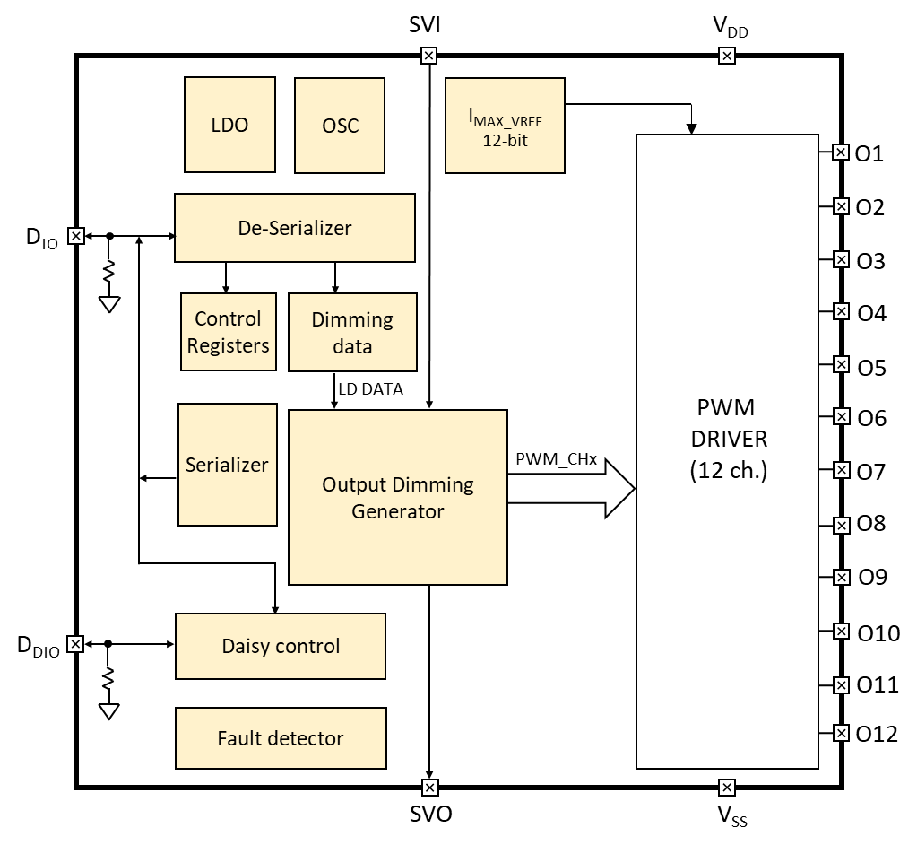
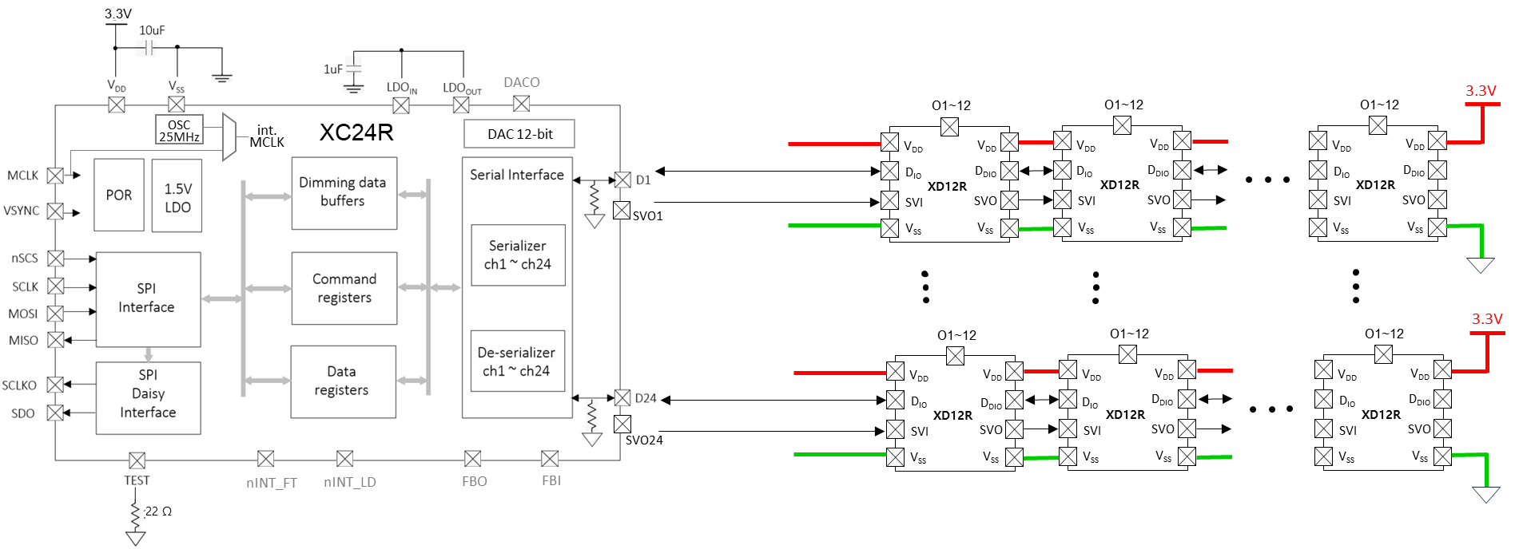
XD12R
Block Diagram
Figure 1. Block Diagram
Application Circuit
Figure 2. Application scheme

Slide 4
XD12R
Pin diagram (Top View)
24
23
22
21
20
19
1
O1
O2
O3
O4
O5
O6
V_{DD}
18
V_{DD}
2
V_{SS}
V_{SS}
17
3
V_{SS}
V_{SS}
16
4
V_{SS}
T-Pad
V_{SS}
15
5
D_{IO}
D_{DIO}
14
6
SVI
SVO
13
O12
O11
O10
O9
O8
O7
7
8
9
10
11
12
Figure 3. Pin diagram
Pin description
Pin Name | Pin No. | I/O | Type | Description | Remark
V_{DD} | 1 | - | Power | Supply voltage
V_{SS} | 2 | - | GND | Ground
V_{SS} | 3 | - | GND | Ground
V_{SS} | 4 | - | GND | Ground
D_{IO} | 5 | I/O | Digital | Data In/Out | Internal PD, 48KΩ
SVI | 6 | I | Digital | External sync. Input | External svsync (+vsync) daisy chain connected
O12 | 7 | O | Current Load | Current Sink 12 | If unused, connect to GND
O11 | 8 | O | Current Load | Current Sink 11 | If unused, connect to GND
O10 | 9 | O | Current Load | Current Sink 10 | If unused, connect to GND
O9 | 10 | O | Current Load | Current Sink 9 | If unused, connect to GND
O8 | 11 | O | Current Load | Current Sink 8 | If unused, connect to GND
O7 | 12 | O | Current Load | Current Sink 7 | If unused, connect to GND
SVO | 13 | O | Digital | External sync. Output | External svsync (+vsync) daisy chain connected
D_{DIO} | 14 | I/O | Digital | Daisied Data In/Out | Internal PD, 48KΩ

Slide 5

XD12R
Pin description
Pin Name | Pin No. | I/O | Type | Description | Remark
V_{SS} | 15 | - | GND | Ground
V_{SS} | 16 | - | GND | Ground
V_{SS} | 17 | - | GND | Ground | @ Test pin
V_{DD} | 18 | - | Power | Supply Voltage
O6 | 19 | O | Current Load | Current Sink 6 | If unused, connect to GND
O5 | 20 | O | Current Load | Current Sink 5 | If unused, connect to GND
O4 | 21 | O | Current Load | Current Sink 4 | If unused, connect to GND
O3 | 22 | O | Current Load | Current Sink 3 | If unused, connect to GND
O2 | 23 | O | Current Load | Current Sink 2 | If unused, connect to GND
O1 | 24 | O | Current Load | Current Sink 1 | If unused, connect to GND
Table 1. Pin Description
Equivalent Circuits of individual pins
Pad Name | I/O | Internal Circuit | Description
D_{IO} | I/O |  | Data In/Out
D_{DIO} | I/O |  | Daisied Data In/Out

Slide 6
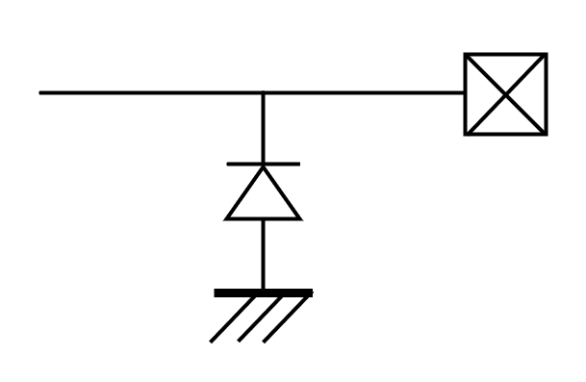

XD12R
Equivalent Circuits of individual pins
Pad Name | I/O | Internal Circuit | Description
O1 ~ O12 | Current Sink |  | Current Load
VDD | - |  | Supply voltage
VSS | - |  | GND
SVI | I |  | Schmit trigger
SVO | O |  | TTL output
V_{DD}
Figure. 4 Equivalent Circuits of individual pins

Slide 7
XD12R
Maximum Absolute ratings (Ta = 25℃ unless otherwise noted)
Parameter | Symbol | Value | Unit
Supply voltage | V_{DD} | -0.3 ~ 6.0 | V
Sink output pin voltage | V_{O} | 40 | V
Sink output current | I_{O} | 40 | mA
D_{IO} to GND | V_{DIO} | -0.3 ~ V_{DD}+0.3 | V
D_{DIO} to GND | V_{DDIO} | -0.3 ~ V_{DD}+0.3 | V
Thermal Resistance
Junction to Ambient | R_{θJA} | 68 ¹⁾ | ℃/W
Junction to Case | R_{θJC} | 4.0 ¹⁾ | ℃/W
Power Dissipation on package | P_{TOT} | 1.0 ¹⁾ | W
Ambient temperature | T_{A} | -20 ~ 85 | ℃
Operating Junction temperature | T_{J} | -20 ~ 150 | ℃
Storage temperature | T_{STG} | -45 ~ 150 | ℃
Relative Humidity (non-condensing) | RH_{NC} | 5 ~ 85 | %
Moisture Sensitivity Level | MSL | Maximum Floor Life-time of 168 hr | 3
Table 2. Maximum Absolute ratings
Note :
1) Surface mounted on FR-4 substrate PC Board 1” x 1” inch 2-oz copper plate, V_{HD} = 2.0V I_{OUT}= 40mA T_{A} = 55℃
2) Stresses beyond the Maximum Absolute ratings may cause permanent damage to the device
3) Exposure to absolute maximum rating conditions for extended periods may affect device reliability.
ESD Ratings
Parameter | Symbol | Value | Unit | Remark
Electrostatic Discharge HBM | ESD_{HBM} | ±2000 | V | Norm: JEDEC JS-001-2017
Electrostatic Discharge CDM | ESD_{CDM} | ±500 | V | Norm: JEDEC JESD22-C101F Oct 2013
Table 3. ESD ratings

Slide 8
XD12R
Electrical Characteristic (V_{DD} =3.3V, Ta=25.0℃ unless otherwise noted)
Characteristics | Symbol | Condition | Value |  |  | Unit
 |  |  | min | typ | max
Supply voltage
Operating voltage | V_{DD}¹⁾ |  | 3.0 | 3.3 | 3.6 | V
Supply current
Quiescent Current | I_{s} | Standby state, No LED current | - | 2.00 | - | mA
Operating Current | I_{DD} | All output 100% Independent of duty sink | - | 3.00 | - | mA
Oscillator
Internal MCLK | f_{OSC} |  | 35 | - | 75 | MHz
In/Out
D_{IO}, D_{DIO} | V_{IL} V_{IH} | Input logic low level | - | - | 0.8 | V
 |  | Input logic high level | 2.0 | - | V_{DD}
 | V_{OL} V_{OH} | Output logic low level | - | - | 0.5 | V
 |  | Output logic high level | V_{DD}*0.8 | - | V_{DD}
 | R_{PD} | Internal pull-down resistance | - | 48 | - | KΩ
Logic long time ²⁾ | T_{1H}, T_{0L} | as a receiver | 6 | - | 63 | MCLK
Logic short time ²⁾ | T_{1L}, T_{0H} | as a receiver | 3 | - | 32 | MCLK
Propagation delay | T_{D_DS} | Downstream (D_{IO} to D_{DIO}) | - | 9.0 | 14 | ns
Propagation output skew³⁾ | T_{DSKEW_DS} | D_{DDIO} T_{1H}=T_{1H}-T_{DSKEW_DS} @downstrm | - | 1.5 | 2.6 | ns
Propagation delay | T_{D_US} | Upstream (D_{DIO} to D_{IO}) | - | 9.5 | 14.5 | ns
Propagation output skew³⁾ | T_{DSKEW_US} | D_{DIO} T_{1H}=T_{1H}-T_{DSKEW_US} @upstream | - | 1.4 | 2.3 | ns
Logic ‘1’
Logic ‘0’
T_{1H}
T_{1L}
T_{0H}
T_{0L}
Note : 1) The operation below V_{DD}, 3.3V will limit a maximum LED sinking current and affect a current variation.
2) The conditions, ①T_{1H} ≥ T_{0H}* 2 ② T_{0L} ≥ T_{1L}* 2 ③ (T_{1H} +T_{0H}) = (T_{0L}+T_{1L}) < 90 are normally recommended.
However, the value depends on the baud-rate of the XC.
3) On downstreaming (or upstreaming), the T_{1H} of D_{DDIO} (or T_{1H} of D_{DIO}) is shorted as many as T_{DSKEW_DS} (or T_{DSKEW_US}), but the total of 1 bit cycle will remain the same.
So, the proper value for T_{1H} and T_{0L} must be carefully determined based on the daisy size.

Slide 9
XD12R
Electrical Characteristic (V_{DD} =3.3V, Ta=25.0℃ unless otherwise noted)
Characteristics | Symbol | Condition | Value |  |  | Unit
 |  |  | min | typ | max
Output
Driving voltage | V_{O} | Headroom voltage V_{HD} : 0.33V@ I_{O} 4mA, 0.35V@ I_{O} 8mA 0.37V@ I_{O} 12mA, 0.39V@ I_{O} 16mA 0.42V@ I_{O} 20mA, 0.44V@ I_{O} 24mA 0.46V@ I_{O} 28mA, 0.48V@ I_{O} 32mA 0.50V@ I_{O} 36mA, 0.53V@ I_{O} 40mA 0.55V@ I_{O} 44mA, 0.57V@ I_{O} 48mA 0.59V@ I_{O} 52mA, 0.62V@ I_{O} 56mA 0.64V@ I_{O} 60mA, 0.67V@ I_{O} 64mA | V_{HD} | - | 40 | V
Short detection voltage ⁴⁾ | V_{SD} | Short detection level V_{SD} : 3b’000=3.5V, 3b’001=6.5V 3b’010=9.5V, 3b’011=12.5V 3b’100/101/110/111 =16.5V | V_{SD} | - | - | V
Open detection voltage ⁴⁾ | V_{OD} |  | - | - | 0.3 | V
Sink current | I_{O} | Device max current level : I_{O} 4’b0000 = 4mA, 4’b0001 = 8mA 4’b0010 = 12mA, 4’b0011 = 16mA 4’b0100 = 20mA, 4’b0101 = 24mA 4’b0110 = 28mA, 4’b0111 = 32mA 4’b1000 = 36mA, 4’b1001 = 40mA 4’b1010 = 44mA, 4’b1011 = 48mA 4’b1100 = 52mA, 4’b1101 = 56mA 4’b1110 = 60mA, 4’b1111 = 64mA | - | - | 64 | mA
Current accuracy ⁵⁾ | % | @ a trimmed point (Room temperature at 25℃) | -1.5 | - | +1.5 | %
LED off current | I_{OFF} | Vo = 40V | - | - | 300 | nA
Feedback
FB threshold voltage (Logically ORed for 12-ch) | V_{FBA} | FB level V_{FBA} : 3’b000 = 0.45V, 3’b001 = 0.55V 3’b010 = 0.65V, 3’b011 = 0.75V 3’b100 = 0.90V, 3’b101 = 1.05V 3’b110 = 1.20V, 3’b111 = 1.35V | - | V_{FBA} | - | V
FB hysteresis voltage | V_{FBH} |  | 40 | 60 | 110 | mV
Thermal protection
Thermal cut off @TJ | TCUT | Default OFS_TEMP [3:0] = 0x8 | - | 130 | - | ℃
Thermal cut off hysteresis @TJ | THYS |  | 10 | 20 | 30 | ℃
Note : 4) If LED open or short event is happened, the corresponding channel will be turned-off under the function
enabled. If the thermal is happened, all channels output will be turned-off under the function enabled.
5) Under satisfying the power dissipation specification.

Slide 10
XD12R
Electrical Characteristic (V_{DD} =3.3V, Ta=25.0℃ unless otherwise noted)
Characteristics | Symbol | Condition | Value |  |  | Unit
 |  |  | min | typ | max
V_{DD} Ramp up and V_{LED} Start
V_{DD} Ramp up time | T_{VDD} | from 0 to stable 3.3V | - | - | 2.0 | ms
V_{LED} Start time | T_{SU_DIM} | after T_{SU_DIM} is completed | ⁶⁾ | - | - | ms
Initialization after V_{DD}, 5V stable
Internal Initial time | T_{INIT} | from stable 3.3V | 100 | - | - | ms
Allowed 1st command | T_{FCMD} | after T_{INIT} is completed | 5 | - | - | ms
Timeout : Internal timer starts after completing to receive a read-back command and stops after first response bit from a last daisied device. This depends on the frequency of MCLK.
Internal Timeout ⁷⁾ | T_{TIMEOUT} |  | - | 131,071 | - | MCLK
VSYNC daisy out @ EXT_VS_E = 1
VSYNCO delay | T_{VSOD} | from VSYNCI to VSYNCO | - | 5.0 | 9.0 | ns
Note : 6) The time depends on the system configuration, the daisied XD12R number and Baud-rate.
7) If the timeout will be expired, the internal communication logic will go to an initial state, so new command
transaction will be possible. The timeout function is configurable.
Table 4. Electrical Characteristic
Important statement
Global Technologies reserves the right to change the above-mentioned information without prior notice.
Power Sequence
V_{DD}
3.3V stable
1st Command to XD12R
T_{VDD}
T_{INIT}
T_{FCMD}
accessible
Set-up for dimming
XD12R setup for dimming
V_{LED}
T_{SU_DIM}
Figure 5. Power up sequence and Ramp-up time

Slide 11
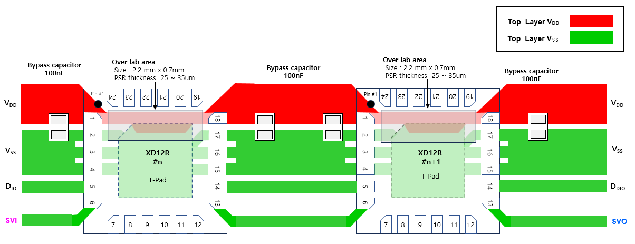
XD12R
Layout for Power Lane for single-layer PCB
As shown in the figure below, it is recommended that a bypass capacitor should be placed as close to the pin 1 and pin 18 as possible in below.
XD12R (Example) Recommended Routing Guidelines for single layer PCB
PCB : single layer
PSR over lab area size : 2.2 x 0.7 mm
PSR thickness : 25~35um↑ To ensure insulation in the overlapping area between the T-PAD and
the Power V_{DD} pattern, a PSR thickness of 25 to 35 µm or more is recommended.)
Clearance : Min 0.17mm ↑ (PAD to PAD, PAD to Pattern, Pattern to Pattern)
Power Pattern width : Please design the power pattern thickness to the maximum thickness as shown in the image
below.
Test Pin location : It is recommended to place the test point (TP) for the LED output pin within 30 mm of the IC,
as it should be located close to the IC.
The test point for control signal lines can be placed anywhere along the net.

Slide 12
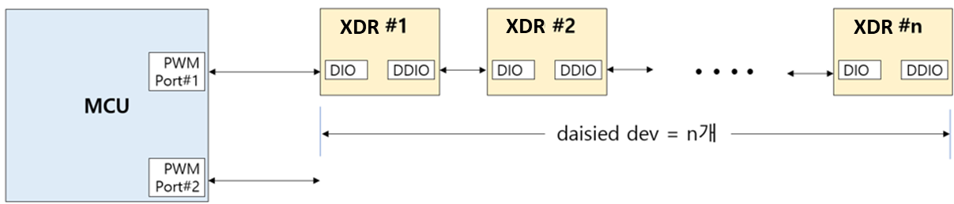
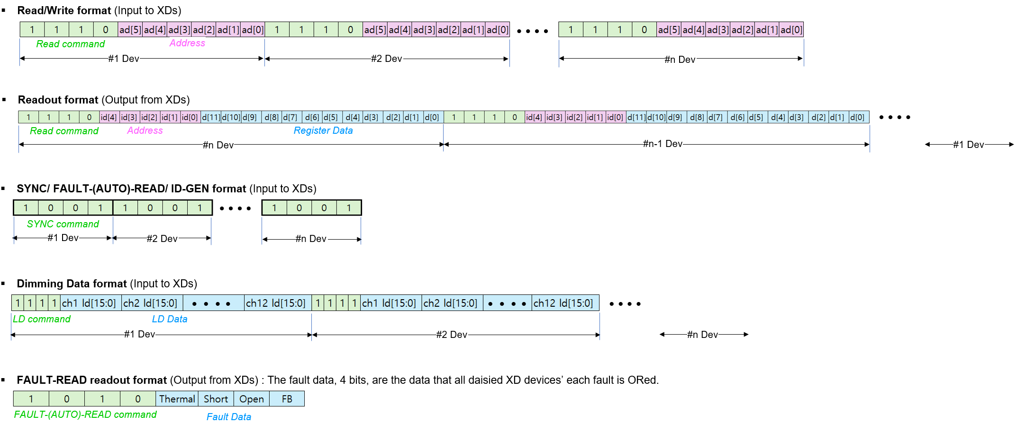
XD12R
Functional Description
Serial Communication Protocol
The XD12R can be controlled with several commands through a XC24R controller or directly by a Micom.
The access protocol and frame format are as follows and if several XD12R is connected in daisy, the commands should be repeated successively as many as the XD12R number in daisy chain.
Table 5. Serial communication protocol @ PC_EN = 0
The serial communication protocol and the packet formats are shown in below for more details.
XC24R
or
MCU
41
LD_TYP=01,PWM_RES=1
41
41
41
41
41

Slide 13
XD12R
Functional Description
PWM Configuration
The PWM behavior depends on PWM configuration set to the PWM_RES and SUB-FRAME
(ex: LD_TYPE =1, svsync / 3) as shown in the Table 6. LD data is applied to the next frame.
PWM_ RES | sub- frame # | LD data[13:0]
 |  | D13 | D12 | D11 | D10 | D9 | D8 | D7 | D6 | D5 | D4 | D3 | D2 | D1 | D0
0 (12-bit) | 4 | x | x | 11 | 10 | 9 | 8 | 7 | 6 | 5 | 4 | 3 | 2 | 1 | 0
 | 8 | x | x | 11 | 10 | 9 | 8 | 7 | 6 | 5 | 4 | 3 | 2 | 1 | 0
 | 16 | x | x | 11 | 10 | 9 | 8 | 7 | 6 | 5 | 4 | 3 | 2 | 1 | 0
 | 32 | x | x | 11 | 10 | 9 | 8 | 7 | 6 | 5 | 4 | 3 | 2 | 1 | 0
1 (14-bit) | 4 | 13 | 12 | 11 | 10 | 9 | 8 | 7 | 6 | 5 | 4 | 3 | 2 | 1 | 0
 | 8 | 13 | 12 | 11 | 10 | 9 | 8 | 7 | 6 | 5 | 4 | 3 | 2 | 1 | 0
 | 16 | 13 | 12 | 11 | 10 | 9 | 8 | 7 | 6 | 5 | 4 | 3 | 2 | 1 | 0
 | 32 | 13 | 12 | 11 | 10 | 9 | 8 | 7 | 6 | 5 | 4 | 3 | 2 | 1 | 0
sub-frames # with max. duty
step # in sub-frame without max. duty
x
don’t care
Table 6. PWM Configuration
(example)
LD_DIR = 1, SUB_FRAME = 4
RED : sub-frames # with max. duty = 2
GREEN : sub-frames # with max. duty = 3
BLUE : sub-frames # with max. duty = 1

Slide 14
XD12R
Functional Description
As shown in Table 7, the XD12R enables flexible channel mapping between time-division channels and non-time-division channels.
CHx_LD_TYPE (register) |  | 0 or 1 | 2 or 3 | 0 or 1 | 2 or 3 | 0 or 1 | 2 or 3 | 0 or 1 | 2 or 3 | 0 or 1 | 2 or 3 | 0 or 1 | 2 or 3
LD transmit sequence |  | 1 | 2 | 4 | 5 | 7 | 8 | 10 | 11 | 13 | 14 | 16 | 17
LD_SIZE(register) = 18 |  |  | 3 |  | 6 |  | 9 |  | 12 |  | 15 |  | 18
CHx_LD_TYPE (register |  | 0 or 1 | 2 or 3 | 2 or 3 | 0 or 1 | 2 or 3 | 0 or 1 | 0 or 1 | 2 or 3 | 0 or 1 | 2 or 3 | 2 or 3 | 0 or 1
LD transmit sequence |  | 1 | 2 | 4 | 6 | 7 | 9 | 10 | 11 | 13 | 14 | 16 | 18
LD_SIZE(register) = 18 |  |  | 3 | 5 |  | 8 |  |  | 12 |  | 15 | 17
CHx_LD_TYPE (register |  | 0 or 1 | 2 or 3 | 2 or 3 | 0 or 1 | 2 or 3 | 0 or 1 | 0 or 1 | 2 or 3 | 0 or 1 | 2 or 3 | x | x
LD transmit sequence |  | 1 | 2 | 4 | 6 | 7 | 9 | 10 | 11 | 13 | 14
LD_SIZE (register) = 15 |  |  | 3 | 5 |  | 8 |  |  | 12 |  | 15
 |  |  |  |  |  |  |  |  |  |  | x means the CHx_EN=0
Table 7. XD12R Flexible channel mapping

Slide 15
XD12R
Functional Description
RGB PWM Dimming
TYPE-A (3-colors)
The Type-A supports dimming 1# LED (RED) and 2# LED (GREEN/BLUE). RED dimming can be generated within 1-frame, regardless of SVI.
Type-A allows for time-division drive of two LEDs(green, blue) per channel.
The XD12R can independently control the current of each RGB LED by driving VREF1/2/3 at separate SVI intervals. Meanwhile, the XC24R provides external VLED selection signals (GATE 2/3) for time-division drive.
VLED1
VLED2
VLED3
GATE3
GATE2
CH_{A}
CH_{B}
CH_{C}
CH_{D}
XD12R
Figure. 7 PWM Dimming sequence @ TYPE-A, LD_DIR = 1

Slide 16
XD12R
Functional Description
RGB PWM Dimming
TYPE-B (4-colors)
The Type-B supports dimming 1# LED (RED) and 2# LED (CYAN) and 3# LED(GREEN/BLUE). RED and CYAN dimming can be generated within 1-frame, regardless of SVI.
VLED1
VLED4
VLED2
VLED3
GATE3
GATE2
CH_{A}
CH_{B}
CH_{C}
CH_{D}
CH_{E}
CH_{F}
XD12R
Figure. 8 PWM Dimming sequence @ TYPE-B, LD_DIR = 1

Slide 17
XD12R
Functional Description
RGB PWM Dimming
TYPE-C (5-colors)
The Type-C supports dimming 1# LED (RED) and 2# LED(GREEN/BLUE) and 3#(CYAN/MAGENTA). RED dimming can be generated within 1-frame, regardless of SVI.
VLED1
VLED2
VLED3
GATE3
GATE2
VLED4
VLED5
CH_{A}
CH_{B}
CH_{C}
CH_{D}
CH_{E}
CH_{F}
XD12R
Figure. 9 PWM Dimming sequence @ TYPE-B, LD_DIR = 1

Slide 18
XD12R
Functional Description
RGB PWM Dimming
TYPE-D (2-colors)
The Type-D supports dimming 2# LED (GREEN/BLUE).
Because RED dimming is not supported, only 2# GATE (GATE2/GATE3) signals are used.
VLED2
VLED3
GATE3
GATE2
CHx
CHy
XD12R
Figure. 10 PWM Dimming sequence @ LD_DIR = 0, TYPE-D

Slide 19
XD12R
Functional Description
PARITY
The XDR12 supports parity function for interface communication with XCR.
TYPE | EVEN PARITY If the number of 1s in the data bits is odd, the parity bit is set to 1.
COMMAND | Supporting all commands except LD transfer command.
RANGE | All area of protocol.
FAIL | If the parity does not match, the command is not executed (daisy transmission is stopped).
Figure 11. Serial communication protocol @ PC_EN = 1

Slide 20
XD12R
Functional Description
Transition a frame frequency without a flicker
Figure 13. PWM 14-bit
Figure 12. PWM 12-bit

Slide 21
XD12R
Register Map
RESET / ID
Acc | Addr | Default | B11 | B10 | B9 | B8 | B7 | B6 | B5 | B4 | B3 | B2 | B1 | B0
R/W | 0x00 | 0x100 | RST | VS_RST | E_RST | LKG_E | x | x | x | ID [4:0]
Bits | Fields |  | Descriptions
11 | RST | 0 1 | NOP All internal logics are initialized to a default state and this bit will be auto-cleared after internal initialization.
10 | VS_RST | 0 1 | NOP If this bit is set, then the serializer and de-serializer of XD12R will be initialized to a default state at every vsync. This bit set does not affect all internal registers and buffers. This bit can’t be set at the same time as the E_RST bit.
9 | E_RST | 0 1 | NOP If this bit is set, then the serializer and de-serializer of XD12R will be initialized to a default state at the last third pwm clock. This function starts from the first vsync input. So, it is careful that the XD12R access at the back of the frame should be avoided for proper operation. This bit set does not affect all internal registers and buffers. This bit can’t be set at the same time as the VS_RST bit.
8 | LKG_E | 0 1 | NOP Enable leakage current mode for driver protection to prevent the VLED voltage from being directly applied to the driver output node
4:0 | ID |  | These bits are read only. If the XD12R will receive the ID-Gen command from the XC24R controller, then the ID value is automatically generated. The ID value is needed for proper reading, so, the ID-Gen command must be firstly executed by the XC24R controller before executing any commands. If all XD12R drivers daisied will receive the ID-Gen command, the last-located device will have the first number of ID, and the first located device will have the last number of ID, that is, the number of daisied devices. The ID value can not be written by a Host.

Slide 22
XD12R
LD CONTROL
Acc | Addr | Default | B11 | B10 | B9 | B8 | B7 | B6 | B5 | B4 | B3 | B2 | B1 | B0
R/W | 0x01 | 0x000 | x | SV_NO [5:0] |  |  |  |  |  | DELAY_CH_EN | SYNCMODE | PWM_RES | LD_DIR | LD_MODE
Bits | Fields | Descriptions
 |  | This register determines the dimming sequence. Even if the LD_MODE and LD_DIR value will be changed in the middle of the current frame, the value will affect the dimming sequence from the next frame after completing the current frame process.
10:5 (0x02) | SV_NO | This bit determines sub-frame NO. in 1-frame. 4 : #4 sub-frames 8 : #8 sub-frames 16 : #16 sub-frames 32 : #32 sub-frames Other register values ​​are unused.
4 | DELAY_CH_EN | This bit determine the Ch. Delay value for LD_MODE 0 Ch. delay value in normal mode 1 Ratio of Ch. delay value in normal mode (Normal mode SVSYNC = 16, 1/2 of the set Ch. delay value)
3 | SYNCMODE | This value determines VSYNC input. 0 command 1 SVI
2 | PWM_RES | This bit determines the PWM resolution. 0 12-bit PWM resolution (max steps 4,095) 1 14-bit PWM resolution (max steps 16,383)
1 | LD_DIR | This bit determines the direction of modulated edge with increasing on time from a vsync. 0 Head Shift Lighting 1 Tail Shift Lighting
0 | LD_MODE | This bit determines the x8 mode. 0 Normal mode 1 x8 mode.
LD SIZE
Acc | Addr | Default | B11 | B10 | B9 | B8 | B7 | B6 | B5 | B4 | B3 | B2 | B1 | B0
R/W | 0x02 | 0x000 | x | x | x | x | x | x | x | LD_SIZE [5:0]
Bits | Fields | Descriptions
4:0 | LD_SIZE | This value determines how many LD data will be transmitted for one time. This value is not needed to match with the number of enabled channels in the CHANNEL ENABLE register. It keeps in mind that the LD data to be transmitted will be mapped sequentially from channel 1 to channel n regardless of the corresponded CHx_EN bit activation.

Slide 23
XD12R
FPWM DIVIDER
Acc | Addr | Default | B11 | B10 | B9 | B8 | B7 | B6 | B5 | B4 | B3 | B2 | B1 | B0
R/W | 0x03 | 0x000 | FPWM_DIV2 [3:0] |  |  |  | FPWM_DIV1 [7:0]
Acc | Addr | Default | B11 | B10 | B9 | B8 | B7 | B6 | B5 | B4 | B3 | B2 | B1 | B0
R/W | 0x04 | 0x000 | FPWM_DIV3 [7:0] |  |  |  |  |  |  |  | FPWM_DIV2[7:4]
Bits | Fields | Descriptions
11:0 11:0 | FPWM_DIV1/2/3 | These registers determine the PWM reference clock. The PWM reference clock can be created by dividing the MCLK frequency by the setting value + 1. Even if the setting value will be changed in the middle of the frame, the value will be applied immediately from the next vsync assertion. Refer to the Tabel 6. for other relevant sets. FPWM_DIV1[7:0] : PWM reference clock for RED LED ( LED1 ) FPWM_DIV2[7:0] : PWM reference clock for GREEN LED ( LED2 ) FPWM_DIV3[7:0] : PWM reference clock for BLUE LED ( LED3 )
CHANNEL ENABLE
Acc | Addr | Default | B11 | B10 | B9 | B8 | B7 | B6 | B5 | B4 | B3 | B2 | B1 | B0
R/W | 0x05 | 0x000 | CH12_EN | CH11_EN | CH10_EN | CH9_EN | CH8_EN | CH7_EN | CH6_EN | CH5_EN | CH4_EN | CH3_EN | CH2_EN | CH1_EN
Bits | Fields | Descriptions
11:0 | CHx_EN | These bits should be set if the corresponding channels are to be used. The number of enabled channels in these registers does not need to match the LD_SIZE value. It is careful that the number of enabled channels should be the same as the LD_SIZE value, but the number can be smaller than the LD_SIZE value like the special mapping below.
CH1_EN | CH2_EN | CH3_EN | CH4_EN | CH5_EN | CH6_EN | CH7_EN | CH8_EN~CH12_EN
1 | 0 | 1 | 1 | 0 | 1 | 1 | all 0
the number of
enabled channels = 5
the amount of LD data to be transmitted for one time
LD_SIZE = 7
wherein, the LD data of the disabled channels, CH2 and CH5, can be any value

Slide 24
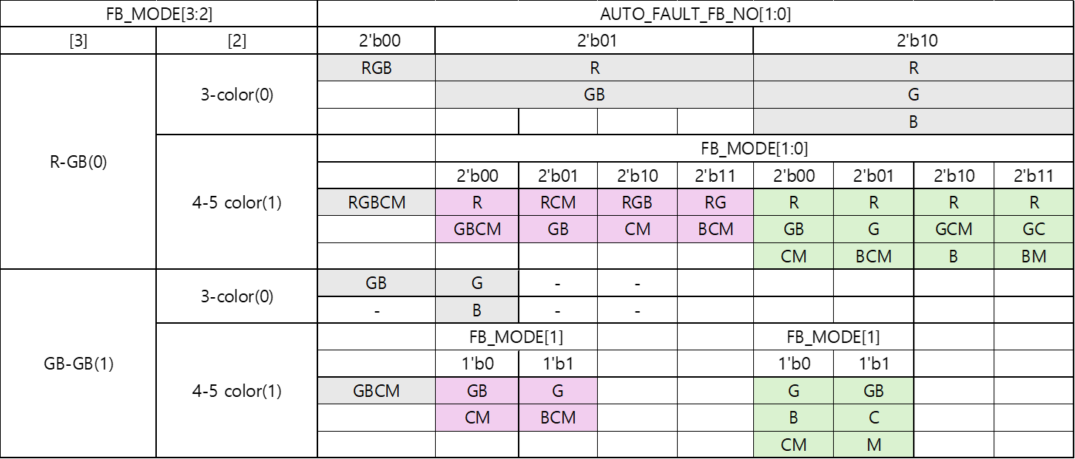
XD12R
FAULT CONTROL
Acc | Addr | Default | B11 | B10 | B9 | B8 | B7 | B6 | B5 | B4 | B3 | B2 | B1 | B0
R/W | 0x06 | 0x040 | AUTO_FAULT_FB_NO[1:0] |  | FB_MODE[3:0] |  |  |  | O_FB_E | S_DET_E | O_DET_E | T_OFF_E | S_OFF_E | O_OFF_E
Bits | Fields | Descriptions
11:10 | AUTO_FAULT_FB_NO | This bit determines the number of FBs output when an auto fault read.
9:6 | FB_MODE | This bit determines for various faults
5 | O_FB_E | This bit setting makes the FB possible to be asserted in only case the corresponding channel’s OPEN event is not happen. If this bit is 0, then the FB can be asserted owing to the OPEN event.
4 | S_DET_E | This bit setting enables to detect the SHORT event, and the event can be detected in only case the corresponding channel’s PWM output is ON status and its channel’s headroom is above the set value in the SHORT_LEVEL register.
3 | O_DET_E | This bit setting enables to detect the OPEN event, and the event can be detected in only case the corresponding channel’s PWM output is OFF status and its channel’s headroom is below 0.25V.
2 | T_OFF_E | This bit setting makes all channels’ output be off in case the THERMAL event happens, and all channels will be activated again after the THERMAL event is cleared.
1 | S_OFF_E | This bit setting makes the SHORTed channel’s output be off in case the SHORT event happens.
0 | O_OFF_E | This bit setting makes the OPENed channel’s output be off in case the OPEN event happens.

Slide 25
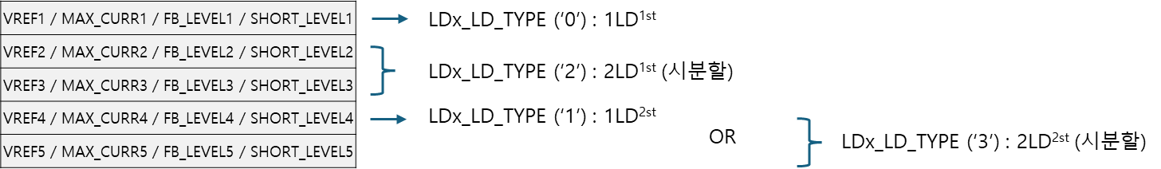
XD12R
CHx_LD_TYPE
Acc | Addr | Default | B11 | B10 | B9 | B8 | B7 | B6 | B5 | B4 | B3 | B2 | B1 | B0
R/W | 0x07 | 0x000 | CH12_LD_TYPE[1:0] |  | CH11_LD_TYPE[1:0] |  | CH10_LD_TYPE[1:0] |  | CH9_LD_TYPE[1:0] |  | CH8_LD_TYPE[1:0] |  | CH7_LD_TYPE[1:0]
Acc | Addr | Default | B11 | B10 | B9 | B8 | B7 | B6 | B5 | B4 | B3 | B2 | B1 | B0
R/W | 0x08 | 0x000 | CH6_LD_TYPE[1:0] |  | CH5_LD_TYPE[1:0] |  | CH4_LD_TYPE[1:0] |  | CH3_LD_TYPE[1:0] |  | CH2_LD_TYPE[1:0] |  | CH1_LD_TYPE[1:0]
Bits | Fields | Descriptions
11:0 | CHx_LD_TYPE | This bit determines whether it is time-sharing data or non-sharing data each CH. 00 non-time-sharing data ( 1LD^{1st}) 01 non-time-sharing data ( 1LD^{2nd}) 10 time-sharing data ( 2LD^{1st}) 10 time-sharing data ( 2LD^{2nd}) This bit determines VREF / MAX_CURR / FB_LEVEL / SHORT_LEVEL.
11?
2LD 2nd

Slide 26
XD12R
FAULT STATUS
Acc | Addr | Default | B11 | B10 | B9 | B8 | B7 | B6 | B5 | B4 | B3 | B2 | B1 | B0
RO | 0x09 | 0x000 | TIMEOUT_ERR | PARITY_ERR | VDD_OV | VDD_UV | LDO_OV | LDO_UV | THERMAL | SHORT | OPEN | FB3 | FB2 | FB1
Bits | Fields | Descriptions
11 | TIMEOUT_ERR | The TIMEOUT_ERR bit indicates no readout case within the count time set in 0x19.
10 | PARITY_ERR | The PARITY_ERR bit indicates a parity error.
9 | VDD_OV | Flag for VDD Over-Voltage
8 | VDD_UV | Flag for VDD Under-Voltage
7 | LDO_OV | Flag for LDO Over-Voltage
6 | LDO_UV | Flag for LDO Under-Voltage
5 | THERMAL | The THERMAL bit indicates whether the THERMAL event due to overheating happens, and this bit will keep asserted as long as the THERMAL event is not cleared. The event threshold can be set by the OFS_TEMP in the TEMP register. If the T_OFF_E bit of the FAULT CONTROL register is set, all output sink drivers will be turned-off as long as the event is asserted, and turned-on again after internal temperature goes down below the set level of the OFS_TEMP. This bit involves other fault events in the readout information, MISS_VS, OV15 and UV15 at the FAULT_(AUTO)_READ transaction.
4 | SHORT | The SHORT bit indicates whether the SHORT event happens. The event can be detected in case some channel’s headroom goes above the set value in the SHORT_LEVEL of FAULT LEVEL register and its channel’s PWM out is ON status. If the S_OFF_E bit of the FAULT CONTROL register is set, the output of the channels in which the event occurs is turned off. This bit is auto-cleared after readout but set again as long as the event is not cleared.
3 | OPEN | The OPEN bit indicates whether the OPEN event happens. The event can be detected in case some channel’s headroom goes below 0.25V and its channel’s PWM out is OFF status. If the O_OFF_E bit of the FAULT CONTROL register is set, the output of the channels in which the event occurs is turned off. This bit is auto-cleared after readout but set again as long as the event is not cleared.
2:0 | FB1/2/3 | The FB bit indicates whether the output channels’ headroom voltage is below the value set by FB_LEVEL of the FAULT LEVEL register due to insufficient VLED. This bit is set whenever the FB event occurs in even one of the activated channels and will be auto-cleared after readout this register. This bit will be set again after readout as long as the FB condition is still valid. If the O_FB_E of FAULT CONTROL register is set, the FB event will happen in case the OPEN event is not asserted. FB1 : FB signal for LED1 FB2 : FB signal for LED2 FB3 : FB signal for LED3

Slide 27
XD12R
MAX CURRENT VREF
Acc | Addr | Default | B11 | B10 | B9 | B8 | B7 | B6 | B5 | B4 | B3 | B2 | B1 | B0
R/W | 0x0A | 0x000 | MAX_CURR_VREF1[11:0] | x | x | x | x | x | x | x | x | x | RST2 | RST1
Acc | Addr | Default | B11 | B10 | B9 | B8 | B7 | B6 | B5 | B4 | B3 | B2 | B1 | B0
R/W | 0x0B | 0x000 | MAX_CURR_VREF2[11:0] | x | x | x | x | x | x | x | x | x | RST2 | RST1
Acc | Addr | Default | B11 | B10 | B9 | B8 | B7 | B6 | B5 | B4 | B3 | B2 | B1 | B0
R/W | 0x0C | 0x000 | MAX_CURR_VREF3[11:0] | x | x | x | x | x | x | x | x | x | RST2 | RST1
Acc | Addr | Default | B11 | B10 | B9 | B8 | B7 | B6 | B5 | B4 | B3 | B2 | B1 | B0
R/W | 0x0D | 0x000 | MAX_CURR_VREF4[11:0] | x | x | x | x | x | x | x | x | x | RST2 | RST1
Acc | Addr | Default | B11 | B10 | B9 | B8 | B7 | B6 | B5 | B4 | B3 | B2 | B1 | B0
R/W | 0x0E | 0x000 | MAX_CURR_VREF5[11:0] | x | x | x | x | x | x | x | x | x | RST2 | RST1
Bits | Fields | Descriptions
11:0 | MAX_CURR_VREF1/2/3/4/5 | The MAX_CURR_VREF1/2/3/4/5 determines the maximum current value of a frame to be dimmed. If the max current level is set to 8mA, then the MAX_CURR_VREF value is proportional to the max current level, and so this value decides the max current reference of all blocks being dimmed for a frame. The setting value will come into effect at the next vsync assertion even if the value is set during current dimming frame earlier than the next vsync.
DELAY CH
Acc | Addr | Default | B11 | B10 | B9 | B8 | B7 | B6 | B5 | B4 | B3 | B2 | B1 | B0
R/W | 0x10 | 0x000 | x | x | DELAY_CH1 [4:0] |  |  |  |  | DELAY_CH2 [4:0]
Acc | Addr | Default | B11 | B10 | B9 | B8 | B7 | B6 | B5 | B4 | B3 | B2 | B1 | B0
R/W | 0x11 | 0x000 | x | x | DELAY_CH3 [4:0] |  |  |  |  | DELAY_CH4 [4:0]
Acc | Addr | Default | B11 | B10 | B9 | B8 | B7 | B6 | B5 | B4 | B3 | B2 | B1 | B0
R/W | 0x12 | 0x000 | x | x | DELAY_CH5 [4:0] |  |  |  |  | DELAY_CH6 [4:0]
Acc | Addr | Default | B11 | B10 | B9 | B8 | B7 | B6 | B5 | B4 | B3 | B2 | B1 | B0
R/W | 0x13 | 0x000 | x | x | DELAY_CH7 [4:0] |  |  |  |  | DELAY_CH8 [4:0]
Acc | Addr | Default | B11 | B10 | B9 | B8 | B7 | B6 | B5 | B4 | B3 | B2 | B1 | B0
R/W | 0x14 | 0x000 | x | x | DELAY_CH9 [4:0] |  |  |  |  | DELAY_CH10 [4:0]
Acc | Addr | Default | B11 | B10 | B9 | B8 | B7 | B6 | B5 | B4 | B3 | B2 | B1 | B0
R/W | 0x15 | 0x000 | x | x | DELAY_CH11 [4:0] |  |  |  |  | DELAY_CH12 [4:0]
Bits | Fields | Descriptions
9:0 | DELAY_CHx | The DELAY_CHx determines from which PWM position the dimming out starts. If this is set to n, then the dimming out starts at (n+1)^{th} PWM position. Normally, the setting value can not exceed the max PWM resolution.

Slide 28
XD12R
FAULT LEVEL
Acc | Addr | Default | B11 | B10 | B9 | B8 | B7 | B6 | B5 | B4 | B3 | B2 | B1 | B0
R/W | 0x16 | 0x000 | FB4_LEVEL [2:0] |  |  | FB3_LEVEL [2:0] |  |  | FB2_LEVEL [2:0] |  |  | FB1_LEVEL [2:0]
Acc | Addr | Default | B11 | B10 | B9 | B8 | B7 | B6 | B5 | B4 | B3 | B2 | B1 | B0
R/W | 0x17 | 0x000 | SHORT3_LEVEL [2:0] |  |  | SHORT2_LEVEL [2:0] |  |  | SHORT1_LEVEL [2:0] |  |  | FB5_LEVEL[2:0]
Acc | Addr | Default | B11 | B10 | B9 | B8 | B7 | B6 | B5 | B4 | B3 | B2 | B1 | B0
R/W | 0x18 | 0x000 | x | x | x | x | x | x | SHORT5_LEVEL [2:0] |  |  | SHORT4_LEVEL [2:0]
Bits | Fields | Descriptions
8:0 | FB1/2/3/4/5_LEVEL | The FB_LEVEL determines the level at which a FB event occurs. 3b’000 : < 0.45V 3b’001 : < 0.55V 3b’010 : < 0.65V 3b’011 : < 0.75V 3’b100 : < 0.90V 3’b101 : < 1.05V 3’b110 : < 1.20V 3b’111 : < 1.35V
8:0 | SHORT1/2/3/4/5 _LEVEL | The SHORT_LEVEL determines the level at which a SHORT event occurs. 3b’000 : > 3.5V 3b’001 : > 6.5V 3b’010 : > 9.5V 3b’011 : > 12.5V 3b’100/101/110/111 : > 16.5V
MAX CURRENT LEVEL
Acc | Addr | Default | B11 | B10 | B9 | B8 | B7 | B6 | B5 | B4 | B3 | B2 | B1 | B0
R/W | 0x19 | 0x000 | MAX_CURR_LEVEL1 [3:0] |  |  |  | MAX_CURR_LEVEL2 [3:0] |  | x | x | MAX_CURR_LEVEL3 [3:0] |  | FB_LEVEL [1:0]
Acc | Addr | Default | B11 | B10 | B9 | B8 | B7 | B6 | B5 | B4 | B3 | B2 | B1 | B0
R/W | 0x1A | 0x000 | x | x | x | x | MAX_CURR_LEVEL5 [3:0] |  | x | x | MAX_CURR_LEVEL4 [3:0] |  | FB_LEVEL [1:0]
Bits | Fields | Descriptions
11:0 | MAX_CURR_ LEVEL1/2/3/4/5 | The MAX_CURR_LEVEL determines the physical maximum current level of the device. The max dimming sink-current set by the MAX_CURR_VREF can not be beyond the MAX_CURR_LEVEL.
Step current | Bit [3:0] | MAX_CURR_LEVEL#
4 mA / Step | 0000 | 4 mA
 | 0001 | 8 mA
 | …. | ….
 | 1110 | 60 mA
 | 1111 | 64 mA

Slide 29
XD12R
PARITY_EN & RD_EN
Acc | Addr | Default | B11 | B10 | B9 | B8 | B7 | B6 | B5 | B4 | B3 | B2 | B1 | B0
R/W | 0x1B | 0x000 | PARITY_EN | x | x | x | x | x | x | x | x | x | x | RD_EN
Bits | Fields | Descriptions
11 | PARITY_EN | This bit determines parity check. 0 parity check disable. 1 parity check enable.
0 | RD_EN | This bit is used to enable Command Register data. 0 register read disable 1 register read enable
SERIALIZER OUTPUT BAUDRATE
Acc | Addr | Default | B11 | B10 | B9 | B8 | B7 | B6 | B5 | B4 | B3 | B2 | B1 | B0
R/W | 0x1C | 0x318 | SERIAL_CLK_LOW [5:0] |  |  |  |  |  | SERIAL_CLK_HIGH [5:0] |  |  | x | x | x
Bits | Fields | Descriptions
11:6 | SERIAL_CLK_LOW | These bits determine the number of MCLK of V_{DD} level in logic low value ‘0’ or the number of MCLK of 0 level in logic high value ‘1’ when the XD12R is driving the D_{IO} pin on read-back. For more details, refer to Table. 4, Logic low time. (unit mclk/2)
5:0 | SERIAL_CLK_HIGH | These bits determine the number of MCLK of V_{DD} level in logic high value ‘1’ or the number of MCLK of 0 level in logic low value ‘0’ when the XD12R is driving the D_{IO} pin on read-back. For more details, refer to Table. 4, Logic high time. (unit mclk/2)
SERIAL LATENCY
Acc | Addr | Default | B11 | B10 | B9 | B8 | B7 | B6 | B5 | B4 | B3 | B2 | B1 | B0
R/W | 0x1D | 0x0C8 | x | x | x | x | SERIAL_LATENCY [7:0]
Bits | Fields | Descriptions
7:0 | SERIAL_LAT | This determines the interval time between the successive data packets incoming from the XC. That means the interval time between the last bit of n^{th} XD12R device’s data packet and the first bit of (n+1)^{th} XD12R device’s data packet incoming from the XC. The setting value should be larger than the 1-bit serial data length time at which the XCR is sending to the daisied XD12R s. So, the proper value depends on the serial baudrate of the XCR and can be set between (1-bit time + 3 MCLKs) and (1-bit time + 5 MCLKs). If the proper value will be set, then the serial data value will be broken. It is careful that this register value should be changed to the proper value firstly in case that the Serializer Output Baudrate of XCR is changed to slow down.

Slide 30
XD12R
V_MASK
Acc | Addr | Default | B11 | B10 | B9 | B8 | B7 | B6 | B5 | B4 | B3 | B2 | B1 | B0
R/W | 0x1E | 0x000 | x | x | V_MASK [9:0]
Bits | Fields | Descriptions
9:0 | V_MASK | The V_MASK determines internal VSYNC position. This register is only valid under (syncmode = 1). Refer the picture below.
SV_MASK
Acc | Addr | Default | B11 | B10 | B9 | B8 | B7 | B6 | B5 | B4 | B3 | B2 | B1 | B0
R/W | 0x1F | 0x000 | SV_MASK_EN | x | SV_MASK [9:0]
Bits | Fields | Descriptions
0 | SV_MASK_EN | The SV_MASK_EN determines SV_MASK function enable or disable. 0 disable, 1 enable
9:0 | SV_MASK | The SV_MASK determines internal SVSYNC rising / falling position.
RSTCNT
Acc | Addr | Default | B11 | B10 | B9 | B8 | B7 | B6 | B5 | B4 | B3 | B2 | B1 | B0
R/W | 0x20 | 0x000 | x | RSTCNT[10:0]
Bits | Fields | Descriptions
10:0 | RSTCNT | The RSTCNT determines RESET position for interface (decoder/encoder) The RSTCNT is counted by a mclk/64 from a last svsync, reset at every vsync
TIMEOUT
Acc | Addr | Default | B11 | B10 | B9 | B8 | B7 | B6 | B5 | B4 | B3 | B2 | B1 | B0
R/W | 0x21 | 0x000 | x | x | TIMEOUT[9:0]
Bits | Fields | Descriptions
9:0 | TIMEOUT | The TIMEOUT is the READOUT output waiting time. If no readout is input for more than TIMEOUT, the read operation is stopped.

Slide 31
XD12R
FLL CONTROL
Acc | Addr | Default | B11 | B10 | B9 | B8 | B7 | B6 | B5 | B4 | B3 | B2 | B1 | B0
R/W | 0x22 | 0x000 | FLLCNT [11:0]
Acc | Addr | Default | B11 | B10 | B9 | B8 | B7 | B6 | B5 | B4 | B3 | B2 | B1 | B0
R/W | 0x23 | 0x864 | FLL_EN | FLL_RANGE[1:0] |  | FLLCNT[20:12]
Bits | Fields | Descriptions
11:0 8:0 | FLLCNT | This determines the FLL target frequency value. The FLLCNT is counted by a mclk/64
11 | FLL_EN | This bit enables the FLL function. The FLL continues to calibrate the MCLK frequency to exactly match the PWM frequency with the time of one frame. 1 Enable FLL function (= The MCLK is unlocking, so calibrated to the target frequency) 0 Disable FLL function (= The MCLK is locking at the current frequency) It is needed that this bit should be set to 0 just before the first vsync starts to be entered to the XD12R and set to 1 just before the vsync is not asserted if the vsync will be not supplied any more to the XD12R .
10:9 | FLL_RANGE | It is recommended to use the default value.
WR_PROTECT
Acc | Addr | Default | B11 | B10 | B9 | B8 | B7 | B6 | B5 | B4 | B3 | B2 | B1 | B0
R/W | 0x24 | 0x555 | WR_PROTECT[9:0]
Bits | Fields | Descriptions
11:0 | WR_PROTECT | These bits are used REGISTER write enable. The purpose of WR_PROTECT is to prevent registers from being unintentionally written. 1. write-protect1 = 0xAAA : PWMCLK_DIV1/2/3, MAX_CURR_VREF1/2/3 writable 2. write-protect2 = 0xCCC : MAX_CURR_VREF1/2/3 writable 3. write-protect3 = 0x555 : all register writable 3. Other values : un-writable

Slide 32
XD12R
NF_CONTROL
Acc | Addr | Default | B11 | B10 | B9 | B8 | B7 | B6 | B5 | B4 | B3 | B2 | B1 | B0
R/W | 0x25 | 0x000 | BBKN_TH[5:0] |  |  |  |  |  | EMI_REJ_EN | SGRJT_EN2 | SGRJT_EN1 | BBKN_EN | DGRJT_EN2 | DGRJT_EN1
Bits | Fields | Descriptions
11:6 | BBKN_TH | The BBKN_TH is a register for detecting short DIN pulses. It is recommended to set BBKN_TH to the max. DIN that should be filtered. The BBKN_TH DIN pulses shorter than this register are not recognized as DIN pulses internally, and the corresponding command is ignored.
5 | EMI_REJ_EN | The EMI_REJ_EN determinant EMI rejection enable. 0 disable 1 enable
4 | SGRJT_EN2 | The SGRJT_EN2 determinant SVI glitch within 4-MCLK rejection enable. 0 disable 1 enable
3 | SGRJT_EN1 | The SGRJT_EN1 determinant SVI glitch within 3-MCLK rejection enable. 0 disable 1 enable
2 | BBKN_EN | The BBKN_TH determinant BBKN_EN function enable. 0 disable 1 enable
1 | DGRJT_EN2 | The DGRJT_EN2 determinant DIN glitch within 4-MCLK rejection enable. 0 disable 1 enable
0 | DGRJT_EN1 | The DGRJT_EN1 determinant DIN glitch within 3-MCLK rejection enable. 0 disable 1 enable
CHOP_EN
Acc | Addr | Default | B11 | B10 | B9 | B8 | B7 | B6 | B5 | B4 | B3 | B2 | B1 | B0
R/W | 0x26 | 0x000 | x | x | x | x | x | x | CHOP_DRV_EN | CHOP_OSCLDO_EN | CHOP_OSC_EN | CHOP_EN | CHOP_DAC_EN | CHOP_BGR_EN
Bits | Fields | Descriptions
5 | CHOP_DRV_EN | The CHOP_DRV_EN enables DRIVER CHOPPING function. 0 disable 1 enable
4 | CHOP_OSCLDO_EN | The CHOP_OSCLDO_EN enables OSC LDO CHOPPING function. 0 disable 1 enable
3 | CHOP_OSC_EN | The CHOP_OSC_EN enables OSC CHOPPING function. 0 disable 1 enable
2 | CHOP_EN | The CHOP_EN must be enabled to use the CHOPPING function. 0 disable 1 enable
1 | CHOP_DAC_EN | The CHOP_DAC_EN enables DAC CHOPPING function. 0 disable 1 enable
0 | CHOP_BGR_EN | The CHOP_BGR_EN enables BGR CHOPPING function. 0 disable 1 enable

Slide 33
XD12R
TEMP
Acc | Addr | Default | B11 | B10 | B9 | B8 | B7 | B6 | B5 | B4 | B3 | B2 | B1 | B0
R/W | 0x27 | 0x820 | OFS_TEMP ]3:0] |  |  |  | VDD_SEL | DAC_RNG | FLT_CTL [1:0] |  | x | x | FLT_GAIN [1:0]
Bits | Fields | Descriptions
11:8 | OFS_TEMP | This determines the temperature level at which the thermal event occurs. The thermal threshold temperature may vary slightly from the set value. The thermal event threshold temperature according to the OFS_TEMP value is mapped as follows. 93/ 99/ 103/ 109/ 113/ 117/ 123/ 127/ 133(default) / 137/ 143/ 147/ 151/ 157/ 161/ 165℃
7 | VDD_SEL | It is recommended to use the default value.
6 | DAC_RNG | It is recommended to use the default value.
5:4 | FLT_CTL | It is recommended to set to 1.
1:0 | FLT_GAIN | It is recommended to use the default value.
OSC FLL MANUAL
Acc | Addr | Default | B11 | B10 | B9 | B8 | B7 | B6 | B5 | B4 | B3 | B2 | B1 | B0
R/W | 0x28 | 0x000 | OSC_FLL_MAN [11:0]
Acc | Addr | Default | B11 | B10 | B9 | B8 | B7 | B6 | B5 | B4 | B3 | B2 | B1 | B0
R/W | 0x29 | 0x808 | OSC_MAN_E |  |  |  |  |  |  |  | OSC_FLL_MAN [15:12]
Bits | Fields | Descriptions
11 | OSC_MAN_E | Enable the manual mode of the FLL module. It is careful that this bit must be cleared during the initialization after POR.
11:0 3:0 | OSC_FLL_MAN | This determines the FLL target frequency value in manual mode.
SPREAD
Acc | Addr | Default | B11 | B10 | B9 | B8 | B7 | B6 | B5 | B4 | B3 | B2 | B1 | B0
R/W | 0x2A | 0x024 | SPRD_EN | x | x | x | x | SPRD_SPD[2:0] |  |  | SPRD_GAIN[3:0]
Bits | Fields | Descriptions
11 | SPRD_EN | This determines SPREAD function enable. 0 disable 1 enable
6:4 | SPRD_SPD | This determines SPREAD step. ('000' :128 clock, '001' :64 clock, '010' : 32 clock, '011' : 16 clock '100’ : 8 clock, '101’ : 4 clock, '110’ : 2 clock, '111’ : 1 clock)
3:0 | SPRD_GAIN | This determines SPREAD gain. (‘000' : calculated value/8, ‘001' : calculated value/4, ‘010’ : calculated value/2, ‘011' : calculated value, ‘100’ : calculated value*2, ‘101’ : calculated value*4, ‘110’ : calculated value*8, ‘111’ : calculated value*16)

Slide 34
XD12R
CLOCK GATE EN
Acc | Addr | Default | B11 | B10 | B9 | B8 | B7 | B6 | B5 | B4 | B3 | B2 | B1 | B0
R/W | 0x2B | 0x017 | x | x | x | x | x | x | x | OTP_MCLK_EN | x | FR2_MCLK_EN | FR1_CLK_EN | DC_MCLK_EN
Bits | Fields | Descriptions
4 | OTP_MCLK_EN | This determines clock gate enable function enable for OTP block. 0 disable 1 enable It is recommended to use the default value.
2 | FR2_MCLK_EN | This determines clock gate enable function enable for 2nd frame buffer. 0 disable 1 enable It is recommended to use the default value.
1 | FR2_MCLK_EN | This determines clock gate enable function enable for 1st frame buffer. 0 disable 1 enable It is recommended to use the default value.
0 | DC_MCLK_EN | This determines clock gate enable function enable for register write / read block. 0 disable 1 enable It is recommended to use the default value.

Slide 35
XD12R
These registers can not go outside the Global Technologies.
OP MODE
Acc | Addr | Default | B11 | B10 | B9 | B8 | B7 | B6 | B5 | B4 | B3 | B2 | B1 | B0
R/W | 0x3F | 0x000 | TEST_EN | TEST_ANA_EN[2:0] |  |  | SW_SEL[2:0] |  |  | PWM_FULL_O | MCLK64_O | DTEST_MUX_EN | EXT_CLKIN | ADDR_EXT
Bits | Fields |  | Descriptions
11 | TEST_EN | 0 1 | NOP It is used to test the device for trimming. To use the PWM_FULL_O, MCLK_O and VREF_O function, this bit should be set firstly and cleared lastly after these functions are used.
10:8 | TEST_ANA_EN | 000 | Should be “000”
7:6 | SW_SEL | 000 | Should be “00”
5 | PWM_FULL_O | 0 1 | NOP Under TEST_EN =1, the enabled channels’ PWM out keeps active state regardless of the vsync.
4 | MCLK64_O | 0 1 | NOP Under TEST_EN =1, the clock obtained by dividing MCLK by 64 is output to DDIO pin.
2 | DTEST_MUX_EN | 0 1 | NOP Under TEST_EN =1, Digital mux signal selection bits for test.
1 | EXT_CLKIN |  | This EXT_CLKIN is used under TEST_EN = 1. Should be “0”
0 | ADDR_EXT | 0 1 | This bit is used to select which register groups, the general registers or the OTP mirror registers, will be accessed. The OTP control registers address, 0x3E ~ 0x3F, can be commonly accessed regardless of this bit. The general registers can be accessed except for the OTP mirror registers. The OTP mirror registers can be accessed except for the general registers.
OTP ACCESS
Acc | Addr | Default | B11 | B10 | B9 | B8 | B7 | B6 | B5 | B4 | B3 | B2 | B1 | B0
R/W | 0x3A | 0x000 | x | x | x | x | x | x | x | x | OTP_PG_ACCESS_CYCLE [15:12] | x | x
Acc | Addr | Default | B11 | B10 | B9 | B8 | B7 | B6 | B5 | B4 | B3 | B2 | B1 | B0
R/W | 0x3B | 0x3FF | OTP_PG_ACCESS_CYCLE [11:0] | x | x | x | x | x | x | I_{D} [4:0] | x | x | RST2 | RST1
OTP WRITE
Acc | Addr | Default | B11 | B10 | B9 | B8 | B7 | B6 | B5 | B4 | B3 | B2 | B1 | B0
R/W | 0x3C | 0x004 | x | x | x | x | x | x | OTP_RD [1:0] |  | OTP_WSEL [3:0] | SHORT | OPEN | FB
OTP RD/PROG
Acc | Addr | Default | B11 | B10 | B9 | B8 | B7 | B6 | B5 | B4 | B3 | B2 | B1 | B0
R/W | 0x3D | 0x000 | x | x | x | x | x | x | x | x | x | x | OTP_RD_START | OTP_PG_START
OTP PROTECT
Acc | Addr | Default | B11 | B10 | B9 | B8 | B7 | B6 | B5 | B4 | B3 | B2 | B1 | B0
R/W | 0x3E | 0x5A5 | PROTECT_EN/DIS [11:0] ※ enable (0x5A5), disable (0xA5A), need to disable for writing | x | x | x | x | x | x | I_{D} [4:0] | x | x | RST2 | RST1

Slide 36
XD12R
These registers can not go outside the Global Technologies.
These registers are the OTP Mirror registers.
OTP CRC
Acc | Addr | Default | B11 | B10 | B9 | B8 | B7 | B6 | B5 | B4 | B3 | B2 | B1 | B0
R/W | 0x00 | 0x000 | x | x | x | x | OTP_CRC_CHECKSUM [7:0] | x | x | x | x | x | x | x
IREF_CTL / BGR_CTL
Acc | Addr | Default | B11 | B10 | B9 | B8 | B7 | B6 | B5 | B4 | B3 | B2 | B1 | B0
R/W | 0x01 | 0x210 | x | x | IREF_CTL[4:0] |  |  |  |  | BGR_TC[4:0]
LDO_DAC_CTL / OSC_RCTL
Acc | Addr | Default | B11 | B10 | B9 | B8 | B7 | B6 | B5 | B4 | B3 | B2 | B1 | B0
R/W | 0x02 | 0x810 | LDO_DAC_CTL[4:0] |  |  |  |  | x | x | OSC_RCTL[4:0] |  | x
LDO_OSC_CTL / LOD_CTL
Acc | Addr | Default | B11 | B10 | B9 | B8 | B7 | B6 | B5 | B4 | B3 | B2 | B1 | B0
R/W | 0x03 | 0x080 | x | x | x | x | LDO_OSC_CTL[3:0] |  |  |  | LDO_CTL[3:0] | x

Slide 37
XD12R
These registers can not go outside the Global Technologies.
OFS_CH 1
Acc | Addr | Default | B11 | B10 | B9 | B8 | B7 | B6 | B5 | B4 | B3 | B2 | B1 | B0
R/W | 0x04 | 0x000 | x | x | x | OFS_CH1 [8:0] |  |  | x | x | x | x
OFS_CH 2
Acc | Addr | Default | B11 | B10 | B9 | B8 | B7 | B6 | B5 | B4 | B3 | B2 | B1 | B0
R/W | 0x05 | 0x000 | x | x | x | OFS_CH2 [8:0] |  |  | x | x | x | x
OFS_CH 3
Acc | Addr | Default | B11 | B10 | B9 | B8 | B7 | B6 | B5 | B4 | B3 | B2 | B1 | B0
R/W | 0x06 | 0x000 | x | x | x | OFS_CH3 [8:0] |  |  | x | x | x | x
OFS_CH 4
Acc | Addr | Default | B11 | B10 | B9 | B8 | B7 | B6 | B5 | B4 | B3 | B2 | B1 | B0
R/W | 0x07 | 0x000 | x | x | x | OFS_CH4 [8:0] |  |  | x | x | x | x
OFS_CH 5
Acc | Addr | Default | B11 | B10 | B9 | B8 | B7 | B6 | B5 | B4 | B3 | B2 | B1 | B0
R/W | 0x08 | 0x000 | x | x | x | OFS_CH5 [8:0] |  |  | x | x | x | x
OFS_CH 6
Acc | Addr | Default | B11 | B10 | B9 | B8 | B7 | B6 | B5 | B4 | B3 | B2 | B1 | B0
R/W | 0x09 | 0x000 | x | x | x | OFS_CH6 [8:0] |  |  | x | x | x | x
OFS_CH 7
Acc | Addr | Default | B11 | B10 | B9 | B8 | B7 | B6 | B5 | B4 | B3 | B2 | B1 | B0
R/W | 0x0A | 0x000 | x | x | x | OFS_CH7 [8:0] |  |  | x | x | x | x
OFS_CH 8
Acc | Addr | Default | B11 | B10 | B9 | B8 | B7 | B6 | B5 | B4 | B3 | B2 | B1 | B0
R/W | 0x0B | 0x000 | x | x | x | OFS_CH8 [8:0] |  |  | x | x | x | x
OFS_CH 9
Acc | Addr | Default | B11 | B10 | B9 | B8 | B7 | B6 | B5 | B4 | B3 | B2 | B1 | B0
R/W | 0x0C | 0x000 | x | x | x | OFS_CH9 [8:0] |  |  | x | x | x | x
OFS_CH 10
Acc | Addr | Default | B11 | B10 | B9 | B8 | B7 | B6 | B5 | B4 | B3 | B2 | B1 | B0
R/W | 0x0D | 0x000 | x | x | x | OFS_CH10 [8:0] |  |  | x | x | x | x
OFS_CH 11
Acc | Addr | Default | B11 | B10 | B9 | B8 | B7 | B6 | B5 | B4 | B3 | B2 | B1 | B0
R/W | 0x0E | 0x000 | x | x | x | OFS_CH11 [8:0] |  |  | x | x | x | x
OFS_CH 12
Acc | Addr | Default | B11 | B10 | B9 | B8 | B7 | B6 | B5 | B4 | B3 | B2 | B1 | B0
R/W | 0x0F | 0x000 | x | x | x | OFS_CH12 [8:0] |  |  | x | x | x | x

Slide 38
XD12R
These registers can not go outside the Global Technologies.
GAIN_CH 1
Acc | Addr | Default | B11 | B10 | B9 | B8 | B7 | B6 | B5 | B4 | B3 | B2 | B1 | B0
R/W | 0x10 | 0x040 | x | x | x | x | x | GAIN_CH1 [6:0] |  | x | x | x
GAIN_CH 2
Acc | Addr | Default | B11 | B10 | B9 | B8 | B7 | B6 | B5 | B4 | B3 | B2 | B1 | B0
R/W | 0x11 | 0x040 | x | x | x | x | x | GAIN_CH2 [6:0] |  | x | x | x
GAIN_CH 3
Acc | Addr | Default | B11 | B10 | B9 | B8 | B7 | B6 | B5 | B4 | B3 | B2 | B1 | B0
R/W | 0x12 | 0x040 | x | x | x | x | x | GAIN_CH3 [6:0] |  | x | x | x
GAIN_CH 4
Acc | Addr | Default | B11 | B10 | B9 | B8 | B7 | B6 | B5 | B4 | B3 | B2 | B1 | B0
R/W | 0x13 | 0x040 | x | x | x | x | x | GAIN_CH4 [6:0] |  | x | x | x
GAIN_CH 5
Acc | Addr | Default | B11 | B10 | B9 | B8 | B7 | B6 | B5 | B4 | B3 | B2 | B1 | B0
R/W | 0x14 | 0x040 | x | x | x | x | x | GAIN_CH5 [6:0] |  | x | x | x
GAIN_CH 6
Acc | Addr | Default | B11 | B10 | B9 | B8 | B7 | B6 | B5 | B4 | B3 | B2 | B1 | B0
R/W | 0x15 | 0x040 | x | x | x | x | x | GAIN_CH6 [6:0] |  | x | x | x
GAIN_CH 7
Acc | Addr | Default | B11 | B10 | B9 | B8 | B7 | B6 | B5 | B4 | B3 | B2 | B1 | B0
R/W | 0x16 | 0x040 | x | x | x | x | x | GAIN_CH7 [6:0] |  | x | x | x
GAIN_CH 8
Acc | Addr | Default | B11 | B10 | B9 | B8 | B7 | B6 | B5 | B4 | B3 | B2 | B1 | B0
R/W | 0x17 | 0x040 | x | x | x | x | x | GAIN_CH8 [6:0] |  | x | x | x
GAIN_CH 9
Acc | Addr | Default | B11 | B10 | B9 | B8 | B7 | B6 | B5 | B4 | B3 | B2 | B1 | B0
R/W | 0x18 | 0x040 | x | x | x | x | x | GAIN_CH9 [6:0] |  | x | x | x
GAIN_CH 10
Acc | Addr | Default | B11 | B10 | B9 | B8 | B7 | B6 | B5 | B4 | B3 | B2 | B1 | B0
R/W | 0x19 | 0x040 | x | x | x | x | x | GAIN_CH10 [6:0] |  | x | x | x
GAIN_CH 11
Acc | Addr | Default | B11 | B10 | B9 | B8 | B7 | B6 | B5 | B4 | B3 | B2 | B1 | B0
R/W | 0x1A | 0x040 | x | x | x | x | x | GAIN_CH11 [6:0] |  | x | x | x
GAIN_CH 12
Acc | Addr | Default | B11 | B10 | B9 | B8 | B7 | B6 | B5 | B4 | B3 | B2 | B1 | B0
R/W | 0x1B | 0x040 | x | x | x | x | x | GAIN_CH12 [6:0] |  | x | x | x

Slide 39

XD12R
Soldering Temperature Reflow Profile
Figure 12. Reflow Soldering information
Parameter | Pb-free soldering conditions
Average ramp-up rate (217 ℃ to Peak) | 3℃/second max.
Time of Preheat temp (from 150 ℃ to 200 ℃) | 60 ~ 120 second
Time to be maintained above 217 ℃ | 60 ~ 150 second
Peak temperature | 260 ℃
Time within 5 ℃ of actual peak temp | 30 second
Ramp-down rate | 6 ℃/second max.
Time from 25℃ to peak temp | 8 minutes max.
Table 8. Reflow Soldering Parameter
Note:
1. The reflow peak soldering temperature is peak 260°C and it is specified based on IPC/JEDEC J-STD- 020 “
Moisture/Reflow Sensitivity Classification for Non-Hermetic Solid State Surface Mount Devices”
2. Tolerance for peak proﬁle temperature (Tp) is deﬁned as a supplier minimum and a user maximum.
3. This document should serve as recommendation only. Other parameters may also affect soldering, so these profiles
do not guarantee absolute success.
4. Soldering profiles should be determined by reference to the solder and solder paste manufacturer's specifications, unless they conflict with the recommendations in this document.
5. The soldering profile and footprint information specified in this datasheet are general recommendations and are provided for reference only. The design, control, and quality assurance of the actual soldering process are the sole responsibility of the customer. The supplier assumes no responsibility for the soldering process or its results.
Important statement
Global Technologies reserves the right to change the above-mentioned information without prior notice.

Slide 40

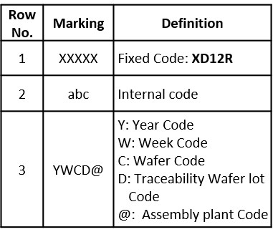





XD12R
Body TOP Marking
< JSICAT marking >
< SEMTECH marking >
XD12R
XD12R
AAA
XXXXX
AAA
abc
CBA2J
YWCD@
CBA2S
TOP VIEW
TOP VIEW
Fix. Code IC Part Name: XD12R
Assembly production Code : CBA2J, CBA2S
※ Example code :2025. 07. 07
wafer Lot #1-5
Package Drawings Markings
Y → Year code
W → Week code , A=W1, B=W2,….
C → Wafer lot, Each wafer Lot is represented by a character (Ex: A, B, C, …).
These character cycle once a week.
** Font Type : Arial
Marking text tolerance : ±0.05mm
D → Traceability Code Wafer lot NO. :
A big assembly Lot consists of three wafers. Each big assembly Lot.
Lot is represented by a character (Ex: 1,2,3,…)
@ → Assembly plant code

Slide 41
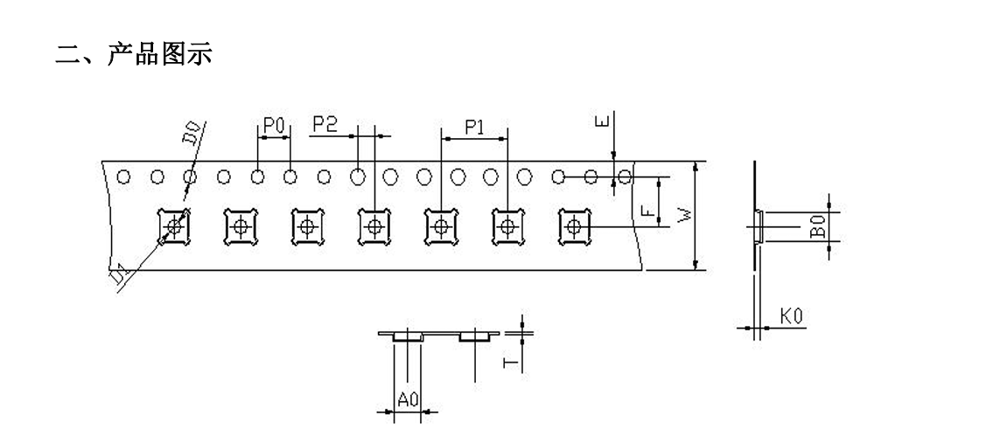

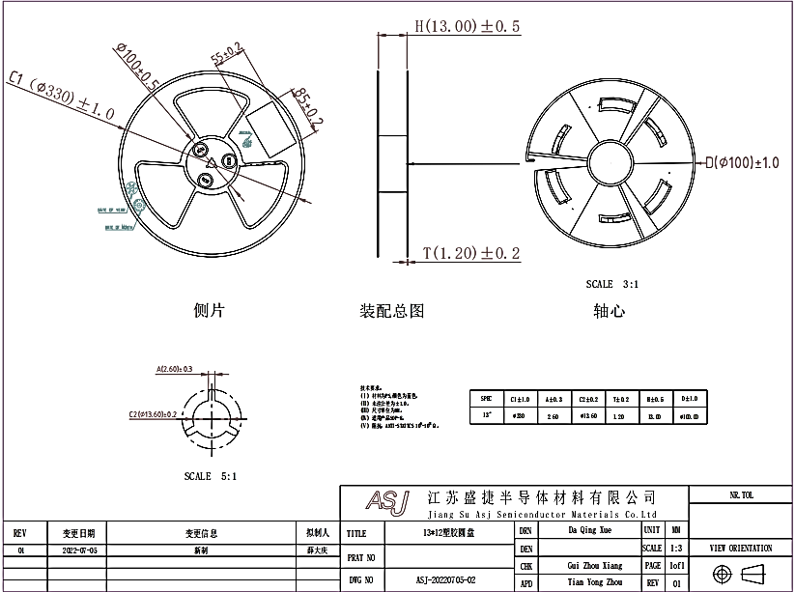
XD12R
Embossed tape and reel data
1) JSICAT
W | 12.00±0.10 | T | 0.20±0.05 | D1 | 1.55±0.10 | 单位 | Mm
E | 1.75±0.10 | F | 5.50±0.10 | D0 | 1.55±0.10 | 材质 | ABS
P0 | 4.00±0.10 | P1 | 8.00±0.10 | P2 | 2.00±0.10 | 品名 | QFN3*3-0.75
A0 | 3.18±0.10 | B0 | 3.22±0.10 | K0 | 0.75±0.10 | 制造商 | 新创源
Figure 13. Tape and reel specification

Slide 42
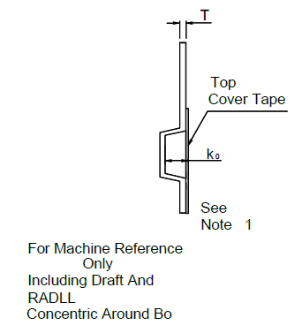
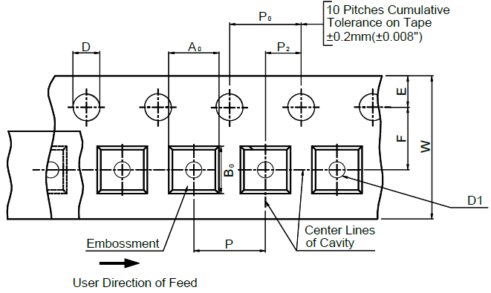
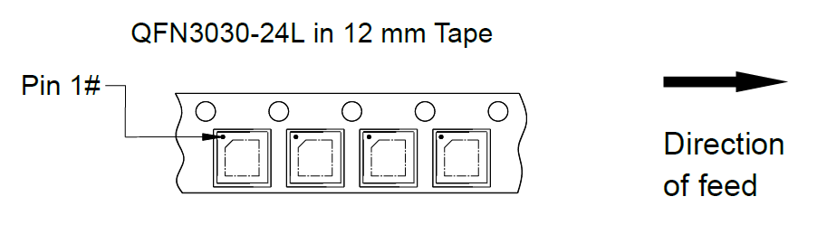
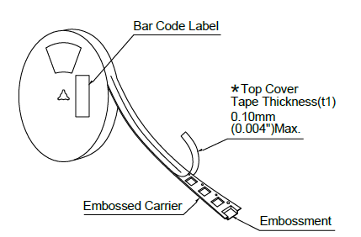
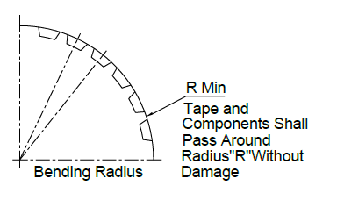
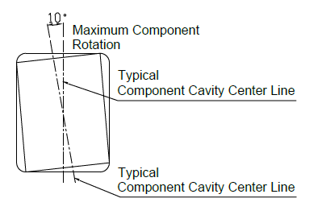
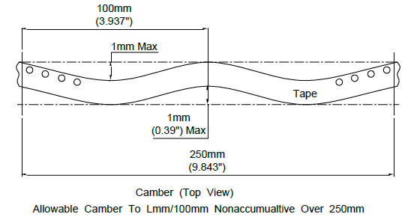
XD12R
2) SEMTECH
Package | Tape Size | D | D1 | E | F | P | P₀ | P₂
QFN3030-24L | 12mm | 1.55±0.1mm (0.061±0.004”) | 1.55±0.1mm (0.061±0.004”) | 1.75±0.1mm (0.069±0.004”) | 5.5±0.1mm (0.217±0.004”) | 8±0.1mm (0.315±0.004”) | 4±0.1mm (0.157±0.004”) | 2±0.1mm (0.079±0.004”)
Package | R Min. | T | W | A0 | B0 | K0
QFN3030 -24L | 25mm (0.98”) | 0.20±0.05mm (0.008±0.002”) | 12mm±0.1mm (0.472±0.004”) | 3.22±0.1 mm (0.127±0.004”) | 3.22±0.1mm (0.127±0.004”) | 0.75±0.1mm (0.03±0.004”)
Figure 14. Tape and reel specification
Note : 1. Metric dimensions govern-English are in parentheses for reference only. 2. The clearance between the components and the cavity must be within 0.05 mm min. to 0.5 mm max.
3. The component cannot rotate more than 10︒ within the determined cavity.

Slide 43
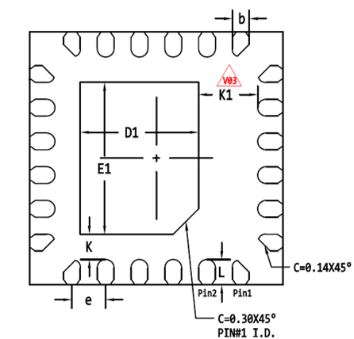
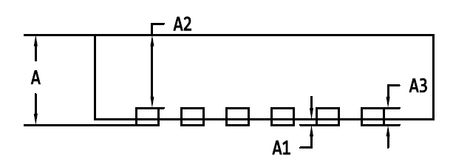
XD12R
Package specification
QFN 3030-24L Package Outline [TBD]
TOP VIEW
BOTTOM VIEW
E
Pin #1
D
SIDE VIEW
Symbol | Dimensions in mm
 | Min | Typ | Max
A | 0.50 | 0.55 | 0.60
A1 | 0.00 | - | 0.05
A2 | 0.45 REF
A3 | 0.152 REF
b | 0.15 | 0.20 | 0.25
D | 2.90 | 3.00 | 3.10
D1 | 1.35 | 1.40 | 1.45
E | 2.90 | 3.00 | 3.10
E1 | 1.75 | 1.80 | 1.85
e | 0.40 BSC
K | 0.25 | 0.30 | 0.35
K1 | 0.65 | 0.70 | 0.75
L | 0.25 | 0.30 | 0.35
Note
All Dimensions Do Not Include mold flash or Protrusions.
Figure 15. Package Outline

Slide 44
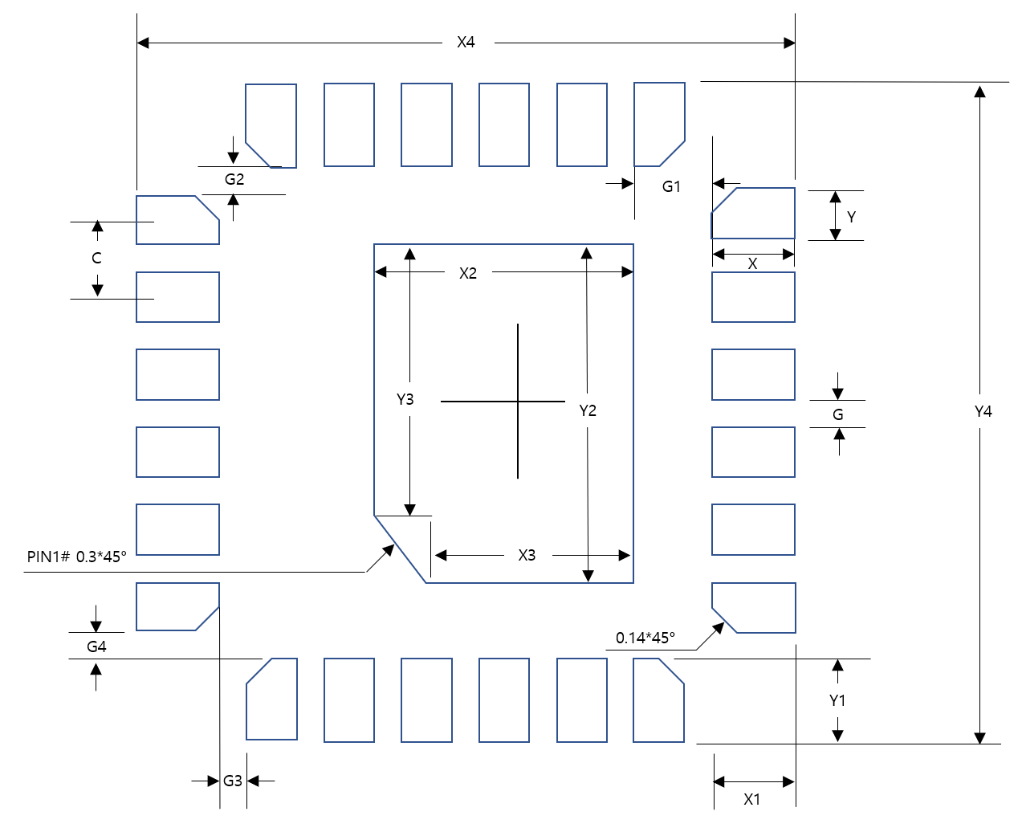

XD12R
Recommended Footprint
Symbol | Dimensions in mm
 | Value | Margin (Typ+)
X | 0.5 | +0.2
Y | 0.2 | 0
C | 0.4 | 0
X1 | 0.5 | +0.2
Y1 | 0.5 | +0.2
X2 | 1.3 | 0
Y2 | 1.8 | 0
X3 | 1.1 | +0.1
Y3 | 1.6 | +0.1
X4 | 3.4 | +0.2
Y4 | 3.4 | +0.2
G | 0.2 | 0
G1 | 0.3 | 0
G2 | 0.1 | 0
G3 | 0.1 | 0
G4 | 0.1 | 0
Figure 16. Recommended Footprint
Note: The reflow peak soldering temperature is peak 260°C and it is specified based on IPC/JEDEC J-STD- 020
“Moisture/Reflow Sensitivity Classification for Non-Hermetic Solid State Surface Mount Devices”
is the trademark of Global Technologies Co., Ltd. or its subsidiaries in the Republic of Korea and/or other countries. The products of Global Technologies reserve the right to make changes without further notice to any products herein. Global Technologies makes no warranty, representation or guarantee regarding the suitability of its products for any particular purpose, nor does Global Technologies assume any liability arising out of the application or use of any product or circuit, and specifically disclaims any and all liability, including without limitation special, consequential or incidental damages. Global Technologies does not convey any license under its patent rights nor the rights of others.
is the trademark of Global Technologies Co., Ltd. or its subsidiaries in the Republic of Korea and/or other countries. Global Technologies owns the rights to a number of patents, trademarks, copyrights, trade secrets, and other intellectual property. Global Technologies reserves the right to make changes without further notice to any products herein. Global Technologies makes no warranty, representation or guarantee regarding the suitability of its products for any particular purpose, nor does Global Technologies assume any liability arising out of the application or use of any product or circuit, and specifically disclaims any and all liability, including without limitation special, consequential or incidental damages. Buyer is responsible for its products and applications using Global Technologies products, including compliance with all laws, regulations and safety requirements or standards, regardless of any support or applications information provided by Global Technologies. “Typical” parameters which may be provided in Global Technologies data sheets and/or specifications can and do vary in different applications and actual performance may vary over time. All operating parameters, including “Typical” must be validated for each customer application by customer’s technical experts. Global Technologies does not convey any license under its patent rights nor the rights of others. Global Technologies products are not designed, intended, or authorized for use as a critical component in life support systems or any FDA Class 3 medical devices or medical devices with a same or similar classification in a foreign jurisdiction or any devices intended for implantation in the human body. Should Buyer purchase or use Global Technologies products for any such unintended or unauthorized application, Buyer shall indemnify and hold Global Technologies and its officers, employees, subsidiaries, affiliates, and distributors harmless against all claims, costs, damages, and expenses, and reasonable attorney fees arising out of, directly or indirectly, any claim of personal injury or death associated with such unintended or unauthorized use, even if such claim alleges that Global Technologies was negligent regarding the design or manufacture of the part. Global Technologies is an Equal Opportunity/Affirmative Action Employer. This literature is subject to all applicable copyright laws and is not for resale in any manner.

